Slide 1


A Waste-Free Entertainment Solution For Green Events

Slide 2



Planning Green Events Can Be Challenging!
People have become more conscious of their environmental and carbon footprints. So naturally, when considering a large event, it is important to think green.
So naturally, when considering a large event, it is important to think green.

Slide 3


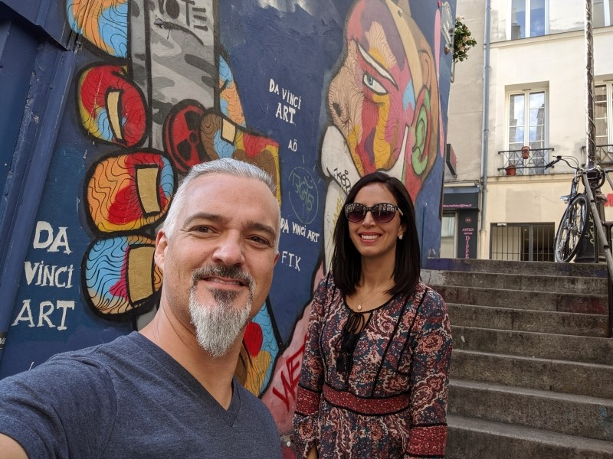
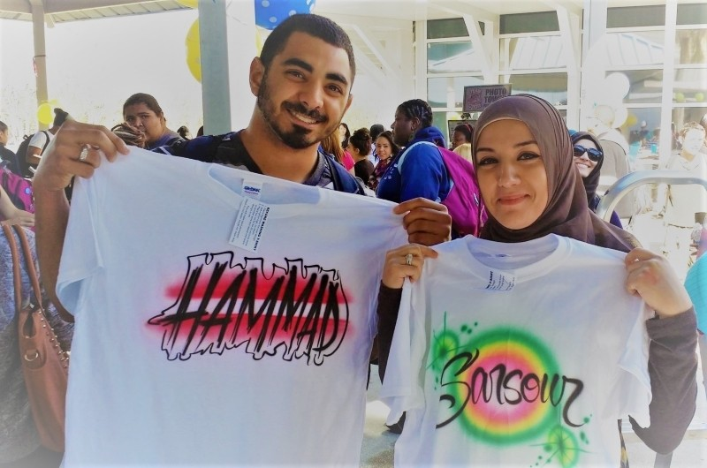
Green Vendors for Green Events
One of the most difficult areas is finding an eco-friendly vendor or entertainer that can provide your guests with a truly great experience, while not breaking the bank, or hurting the planet. One of the most eco-friendly green event entertainment options is Airbrush Events.
They’ve incorporated this minimalist philosophy into the structure of Airbrush Events. Because of this philosophy, you know their business would make a great option for green events.

Slide 4
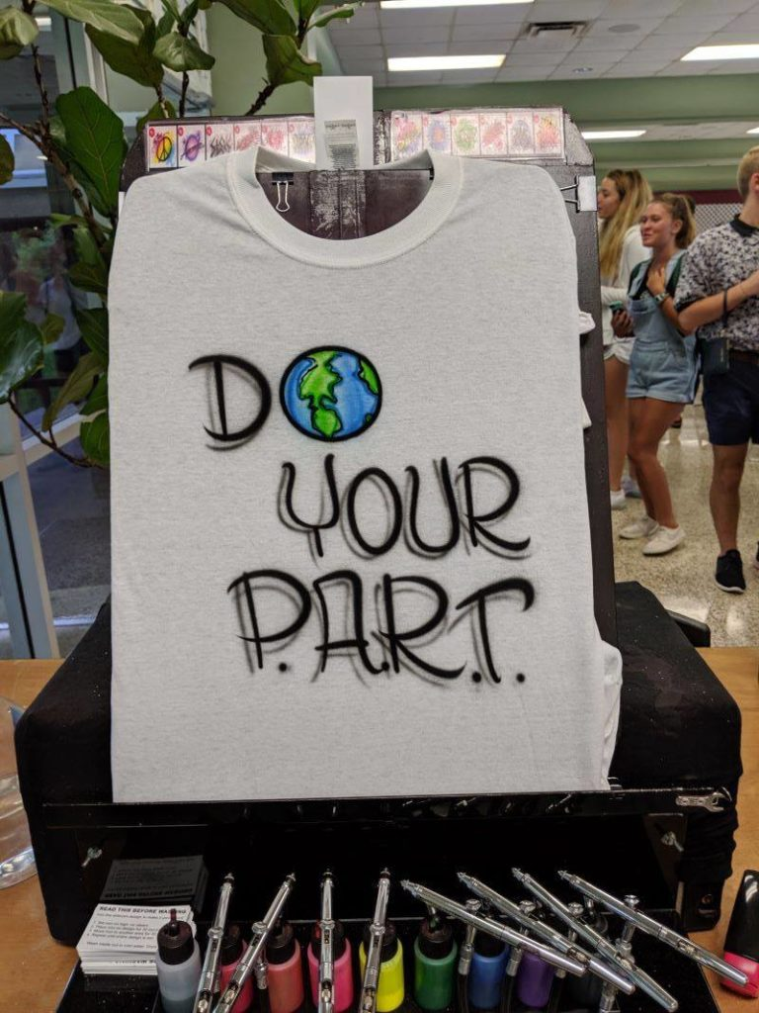


Party Favors For Green Events Your Guests Will Love
Airbrush Events provides party favors and entertainment that is different from the mass-produced plastic giveaways and messy, wasteful entertainment.
Every attendee gets to choose directly what they want. There isn’t a waste of time or material on people who don’t really care for a party favor. Most large events have a lot of waste, due simply to people not wanting what is being offered.

Slide 5

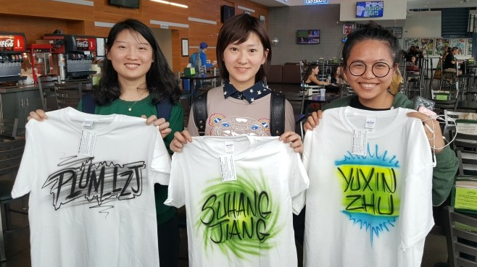
Personalization Creates Memories
A major win is the personalization by the artists. Not only is it less wasteful but it’s so much more fun to have a personalized item as opposed to a mass-produced one.
Airbrush Events bring their own shirts and let the event-goers customize them however they want. It’s as simple as that.
Letting your attendees decide what they want on their swag helps create a connection between the event and the item.

Slide 6


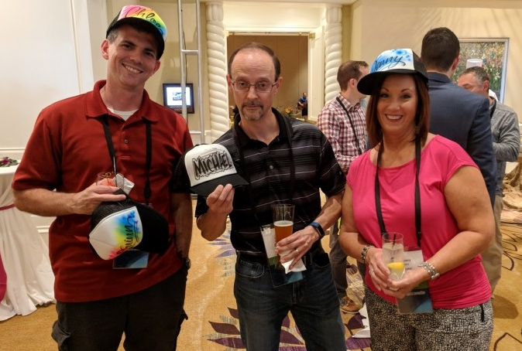
A Party Favor That Gets The Crowd Talking
Beyond that aspect, Airbrush Events is also great entertainment for your green event. They provide essentially wasteless fun for all the event participants.
Another major benefit is the clothes and hats created by the airbrush artists, make for a great icebreaker. Guests usually want to throw on their new swag right away. Having a custom tee with their name on it is a great way to encourage networking at the event.

Slide 7


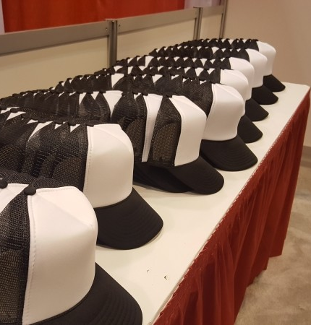
Keeping It Low Waste
Airbrush Events cares about the environment and its impact on the earth. Airbrush Events make sure no tees or hats up in the trash. They donate them instead to local homeless shelters so that they can be benefited from those in the community.
Almost nothing is thrown away, misordered items are resold at a discount and this is due to the minimalist and environmentally-friendly business approach that Airbrush Events uses.

Slide 8

If you are looking to make sure your event stays both fun and environmentally friendly, Airbrush Events is one of the best party favors providers and entertainers you can hire for an event. Partner up with a company that cares just as much about the planet as you do and who’ll make your green event a blast!

