Slide 1

How to Build Brand Awareness with Promotional Gifts

Slide 2

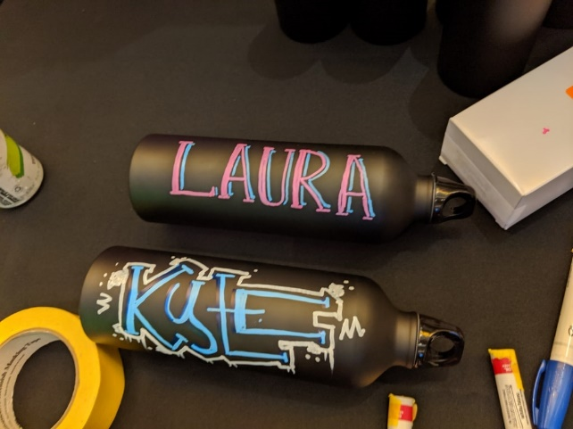
Why Brand Awareness?
Why do companies spend money giving away promotional gifts? Let’s all sing the lyrics from the theme song of Fame … ‘Baby remember my name’.
It’s as simple as that, it’s an investment in brand awareness. To be more technical, the pinnacle of brand awareness is called proprietary eponym. This simply means a brand has become so well known it is used generically to describe a product or service.

Slide 3
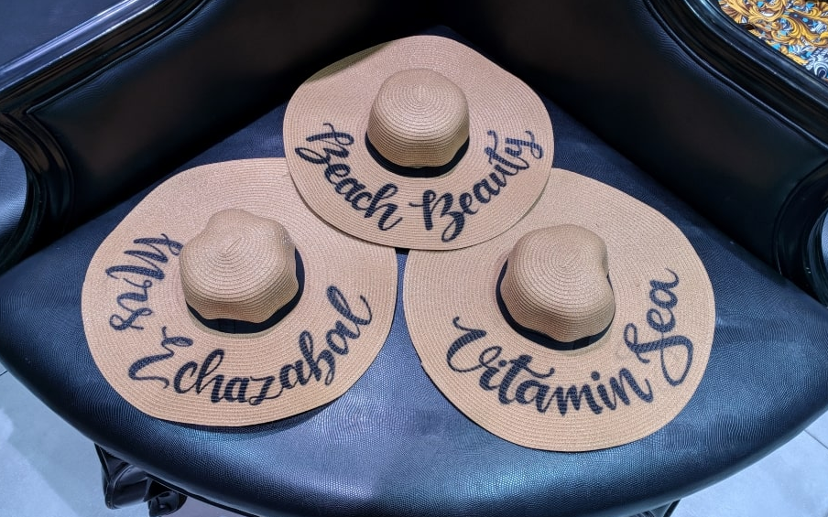
Using Promotion Gifts to Make a Connection
A good free promotional gift needs to be useful, something the person will interact with as often as possible. And the more personal a promotional gift is, the more likely they’ll hold onto it. Think water bottles, mugs, keyrings, pens, T-shirts, hats, etc.
If these only contain company branding, the receiver has no connection to the object. A simple addition of a personalized design and the connection is made.

Slide 4

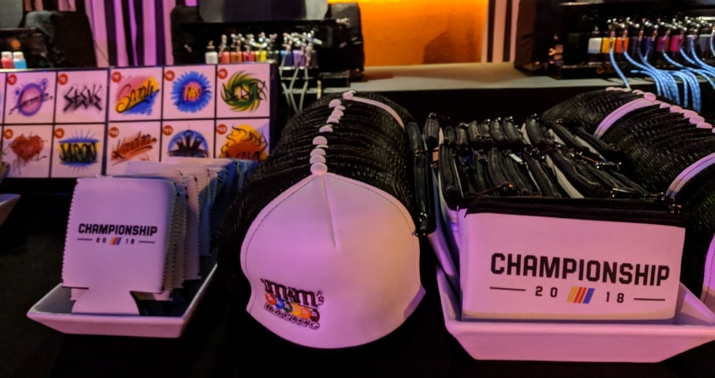
Choose Promotional Gifts
WISELY
Whether it’s a job interview, a date or a promotional gift, first impressions count
Airbrush Events can boost your brand awareness. We work with established businesses looking for smart and innovative ways to stand out in the crowd. And also new startups developing a brand identity.
Along with private and corporate hosting events where we custom airbrush t-shirts, hats, and other funky goodies as party favors. We also attend corporate promotional events to help build brands.
Your Brand Awareness

Slide 5

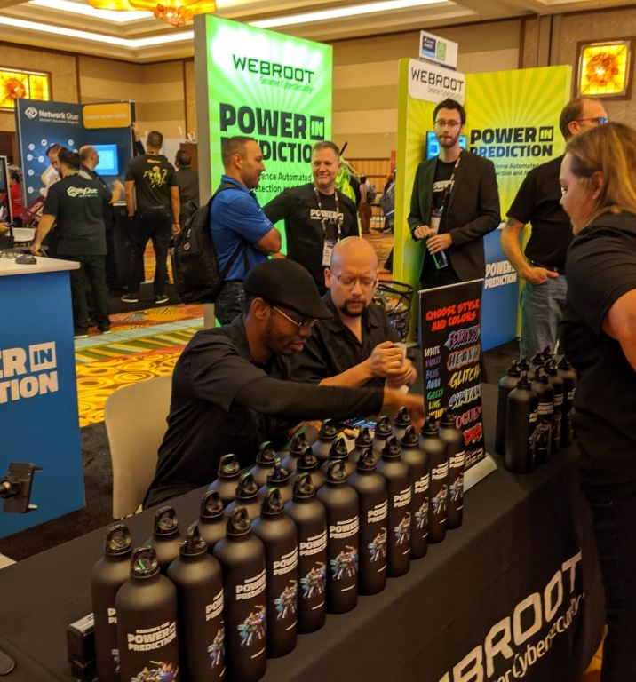
Making Your Booth Stand Out in a Convention
When you are one of many booths at a convention, all pitching similar products and services, how do you stand out and attract guests to your booth? You entertain people and ensure they leave with a useful custom product with which they have a connection.
We were recently employed by WEBROOT, a cybersecurity company offering anti-virus solutions. They had a booth at the IT Nation Connect 2019 Convention in Orlando. We had a great time customizing their water bottles.

Slide 6
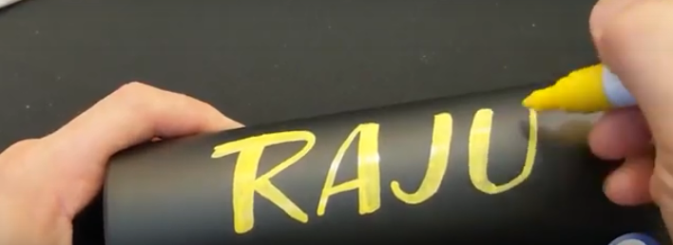
Painting on Stainless Steel Bottles
The stainless steel water bottles provide a non-porous surface, which causes airbrushed paint to move around. To solve this, we used paint pens, which dry quickly, are permanent and the bottles can be washed without affecting the design. Paint pens also offer a solution when space is limited.
We produced 550 custom water bottles working 11 hours across three days. WEBROOT used these as corporate promotional gifts to build brand awareness.
Customizing while being entertained is a WINNING COMBO!

Slide 7
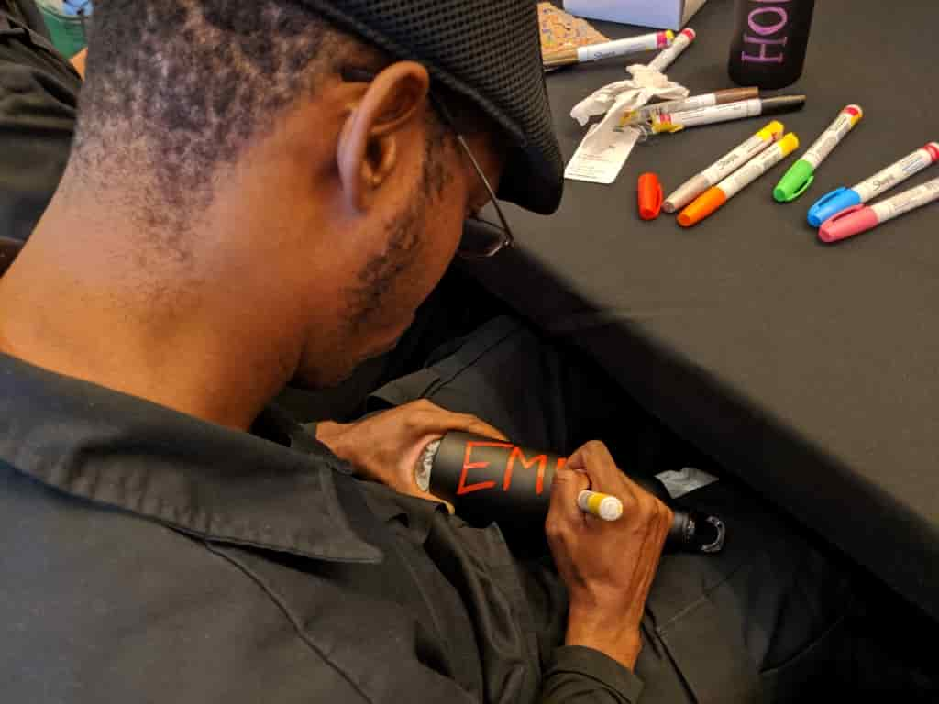
Water Bottles Are Good Promotional Gifts
The beauty of this particular corporate gift is it has the potential to go everywhere the customer goes (home, work, gym, car, shopping, etc.), so wherever the bottle goes, your brand goes along.
Not only that but water bottles will really connect your brand with the growing environmentally-friendly consumers out there. People are becoming more aware of the impact of single-use disposable cups and bottles and the damage they are causing to our planet. It is now viewed as eco-friendly to carry a water bottle as it helps to stop the use of plastic or paper disposable cups.

